Slide 1
In Defense of the Container Theory: A Contribution to the Metaphysics of Pregnancy
Barry Smith
March 2, 2019

Slide 2
Kelly E. Maier, “Pregnant Women: Fetal Containers or People with Rights?”, Affilia, 4:2, 1989
When fetal rights take precedence over women’s rights, women are, in effect, declared nonpersons under the law. This article explores these issues and social workers’ ethical and professional responsibilities with respect to unwanted medical treatment of pregnant women under the guise of “child protection” concerns, taking as a case in point the recent Canadian decisions regarding Baby R.

Slide 3
Laura M. Purdy, “Are Pregnant Women Fetal Containers?”, Bioethics, 4:4, 1990
Let me relieve your curiosity right away: yes, pregnant women are fetal containers. That is, they have fetuses in their bodies. But the implication from this fact drawn by some people from the phrase – that women are nothing but cheap clay pots supporting infinitely precious flowers –f is very far from being the case.
Women carry fetuses in their bodies, it is true. It is equally true, however, that fetuses are part of women’s bodies.

Slide 4
2018

Slide 5
This article argues that a particular metaphysical model permeates cultural practices surrounding pregnancy: the foetal container model. Widespread uncritical reliance on this view of pregnancy has been highly detrimental to women’s liberty and reproductive autonomy.

Slide 6
… the only work which explicitly attempts to justify the foetal container model of pregnancy is Brogaard and Smith’s description of the maternal-foetal relationship as a ‘tenant-niche’ relation, comparing the gestating foetus to a ‘tub of yogurt’ in the refrigerator …

Slide 7
2003
http://ontology.buffalo.edu/smith/articles/embryontology.pdf

Slide 8
2002

Slide 10
Double hole structure of the occupied niche

Slide 11
Four kinds of niche correspond to four kinds of protection egg trench field zone
from “Surrounding Space”

Slide 12
Type 1 niche:
high protection vs. difficulty of escape
egg, womb, coffin, fridge with door closed,
submarine, spaceship

Slide 13
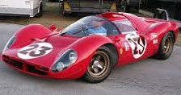
Type 1 niche:
high protection vs. difficulty of escape
race car circa 2000

Slide 14
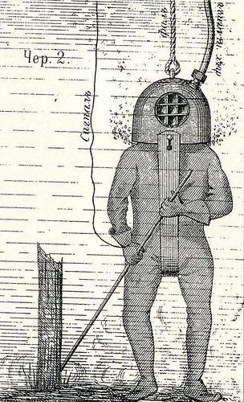

Slide 15
Notes:
http://gizmodo.com/the-evolution-of-the-atmospheric-diving-suit-1537111854

Slide 16
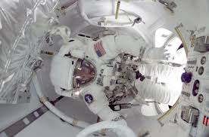
Contained in, not a part of, the space ship

Slide 17
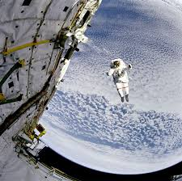
Not contained in, and not a part of, the space ship

Slide 18
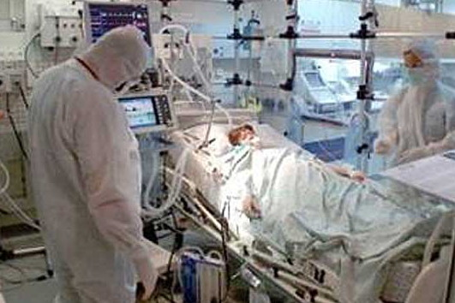
Notes:
http://moramedica.cz/produkty/en/isolation-pandemic-protection-systems-mobile-surgery-centres/94/

Slide 19
Type 2 niche:
reduced protection vs. ease of escape

Slide 20
race car circa 1930
Type 2 niche:
reduced protection vs. ease of escape

Slide 21
Mother is not a fetal container
Rather, the mother contains a fetal container, an interior niche, which offers high protection
The mother is a protectrix

Slide 22
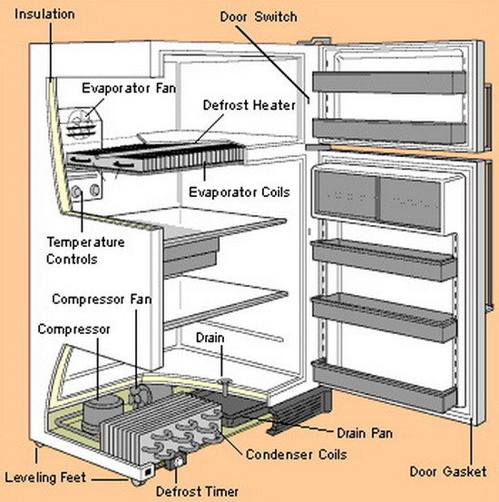
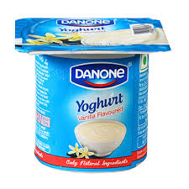
The fridge provides protection,
and temperature control,
for the tub of yoghurt

Slide 23
The fridge provides protection,
a safe space

Slide 24
The fridge provides protection,
a safe space,
and temperature control for the tub of yoghurt

Slide 25
fridge does not provide food, oxygen … to the yoghurt

Slide 26
Intelligent design

Slide 27
Mother is a food processing plant

Slide 28
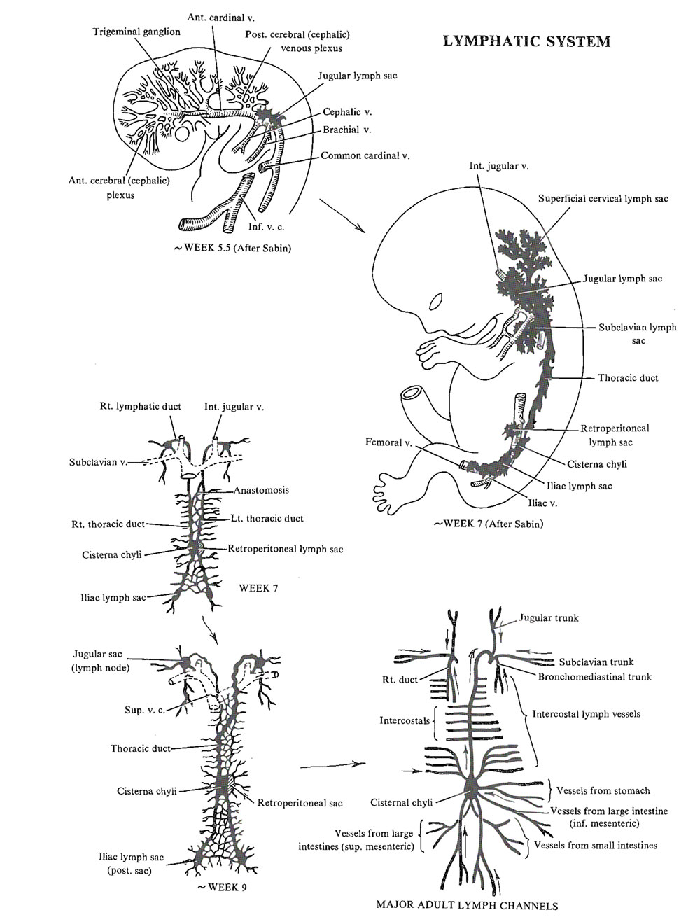
Development of the lymphatic system
Week 5.5
Week 7
Week 9
Notes:
https://discovery.lifemapsc.com/library/review-of-medical-embryology/chapter-128-development-of-the-lymphatic-system

Slide 29
Mother is a container for a biosafety cabinet (green PICU)
The measure of biological species / civilizations:
the degree to which they provide protection / education for their young
Notes:
https://discovery.lifemapsc.com/library/review-of-medical-embryology/chapter-128-development-of-the-lymphatic-system

Slide 30
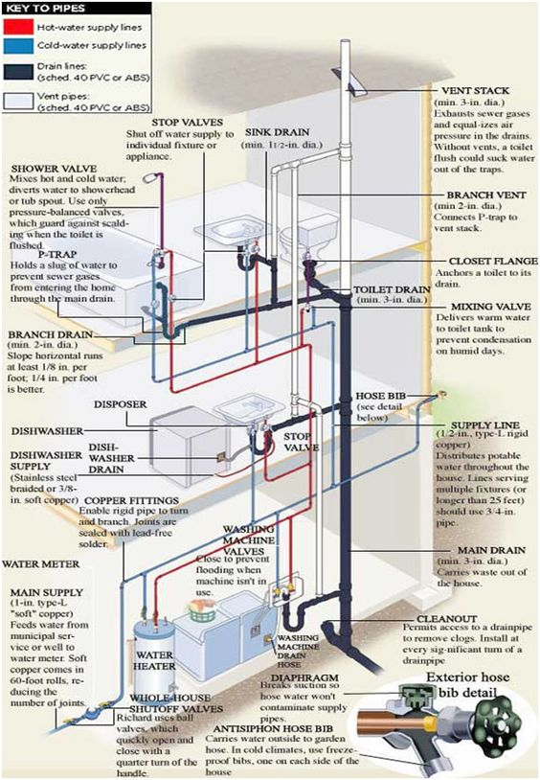
home = regulated environment
Notes:
https://www.pinterest.com/pin/301530137524295325/

Slide 31
https://www.nature.com/articles/nri.2017.64.pdf

Slide 32
Transplant
Tumor
Early Pregnancy
Notes:
https://www.nature.com/articles/nri.2017.64.pdf

Slide 33
Cancer metastatic implantation
vs.
Blastocyst implantation
Apposition
Attachment
Invasion
Inflammation
Notes:
https://www.nature.com/articles/nri.2017.64.pdf

Slide 34
3 immunological stages of pregnancy
Notes:
https://www.nature.com/articles/nri.2017.64.pdf

Slide 35
3 immunological stages of pregnancy
Inflammatory phase in third trimester = the fetus is preparing for escape from its niche
There is no counterpart for this phenomenon in any other comparable phenomenon – neither for grafts nor for tumors
Notes:
https://www.nature.com/articles/nri.2017.64.pdf

Slide 36
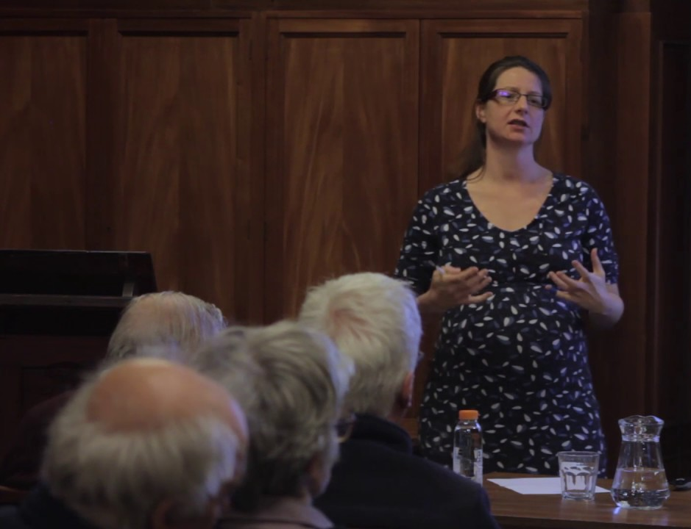
Elselijn Kingma
Notes:
https://www.youtube.com/watch?v=COZEansw_Ts

Slide 37
In this paper I argue that … fetuses/embryos are Lady-Parts: part of the maternal organism from implantation up until birth.

Slide 38
Notes:
https://www.pnas.org/content/114/32/E6566

Slide 39
Semantic clustering of significantly overrepresented GO terms in differentially expressed genes
Semantic clustering of significantly overrepresented Gene Ontology terms in differentially expressed genes

Slide 40
Semantic clustering of significantly overrepresented GO terms in differentially expressed genes

Slide 41
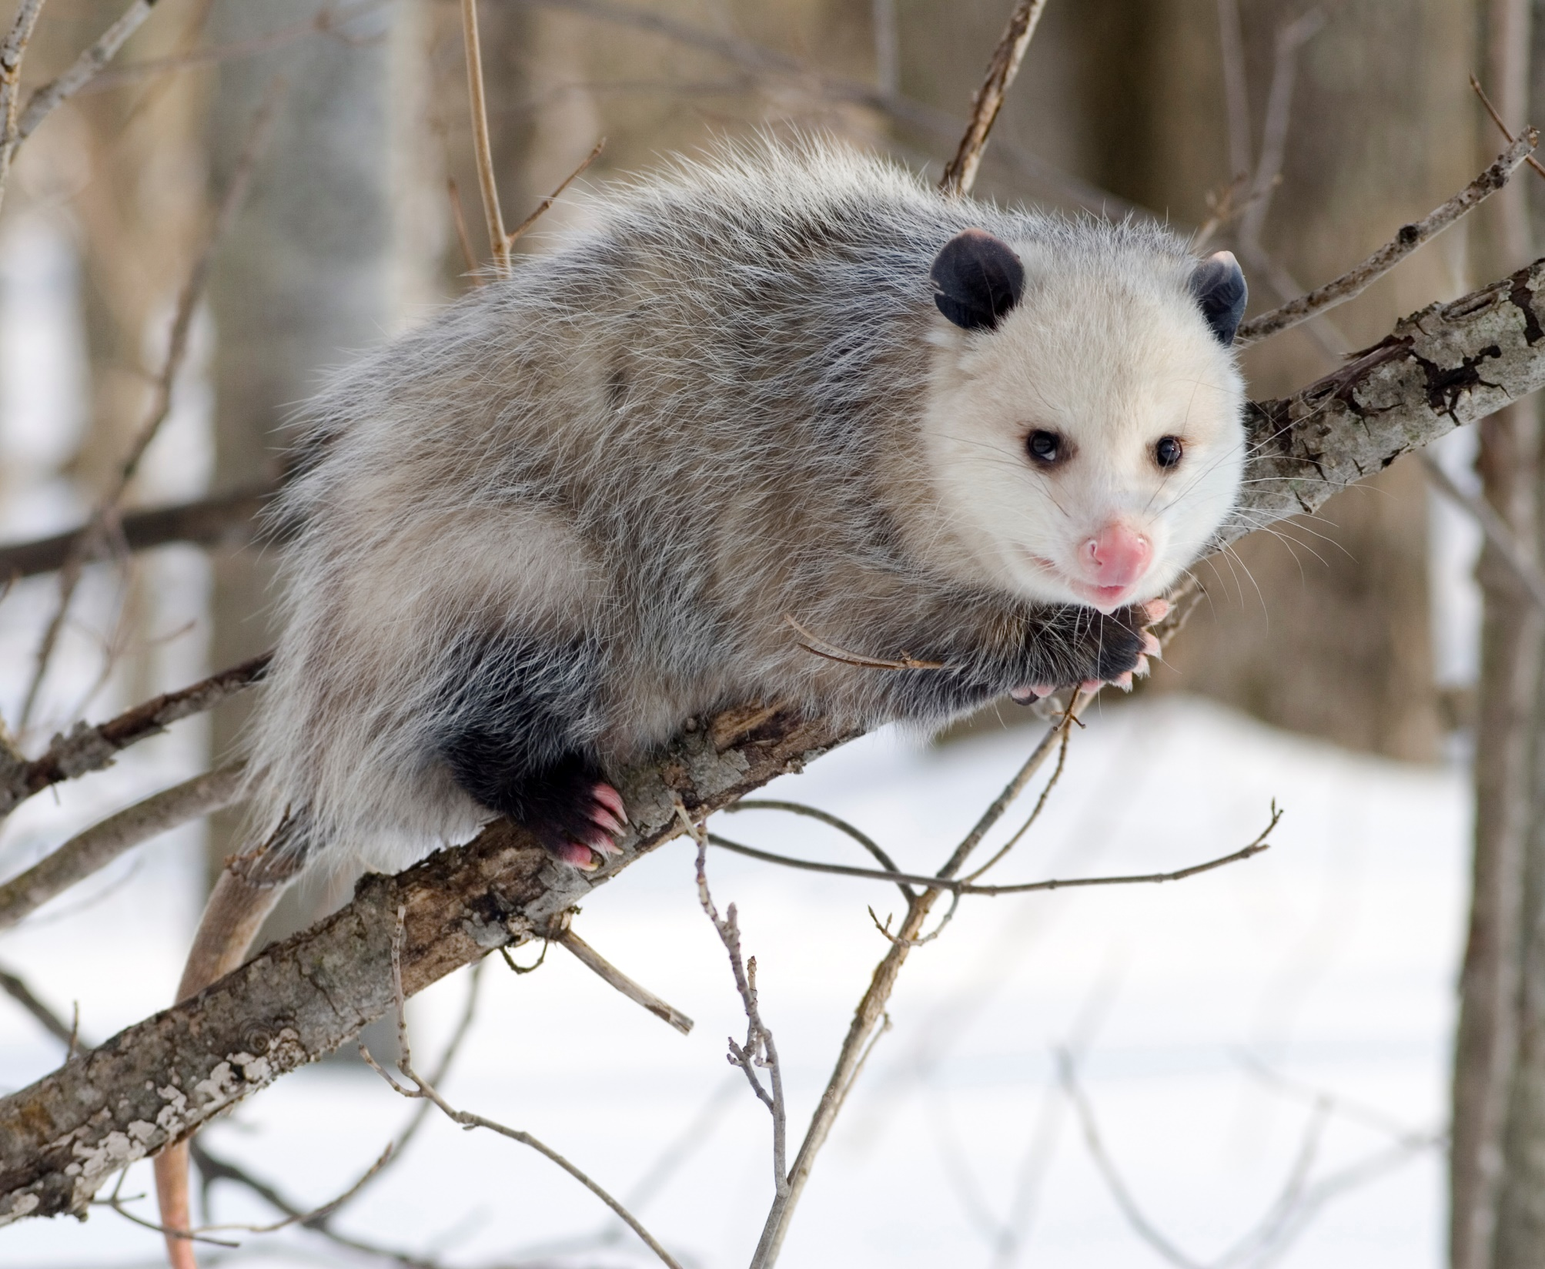

Slide 42
Notes:
https://www.pnas.org/content/114/32/E6566

Slide 43
Wallaby

Slide 44
Notes:
https://www.youtube.com/watch?v=2lCKc8tURtc

Slide 45
Notes:
https://www.youtube.com/watch?v=2lCKc8tURtc

Slide 46
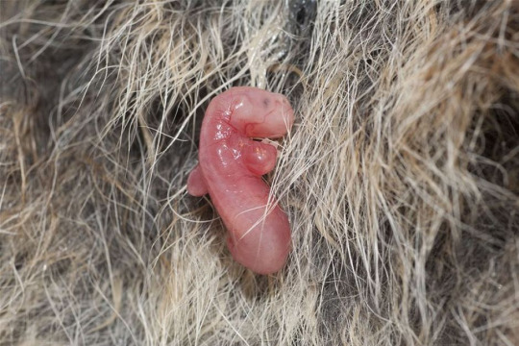
Notes:
http://candidscience.tumblr.com/post/65002140685/marsupials-the-pouch-life-marsupial-pregnancies, http://www.sciencedaily.com/releases/2013/03/130315202701.htm

Slide 48
Notes:
https://www.youtube.com/watch?v=2lCKc8tURtc

Slide 49
Notes:
https://www.youtube.com/watch?v=2lCKc8tURtc

Slide 50
Elselijn’s view would work only for placental mammals
Marsupials have no umbilical cord
But very early development of strong limbs for climbing

Slide 52
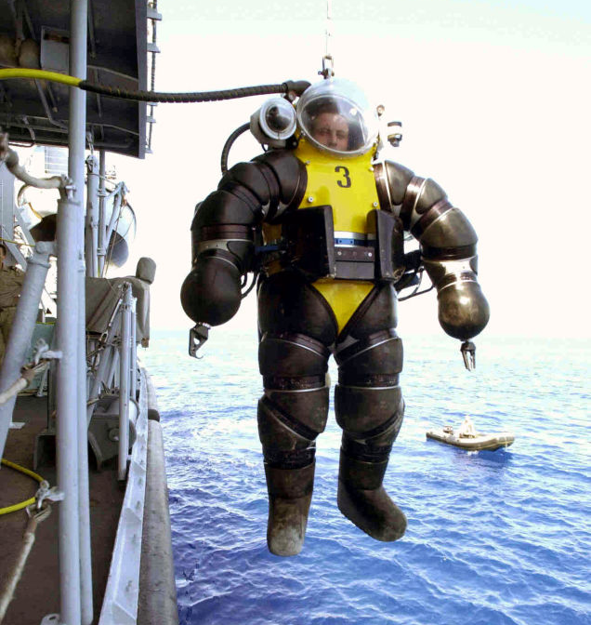
Notes:
http://gizmodo.com/the-evolution-of-the-atmospheric-diving-suit-1537111854

Slide 53
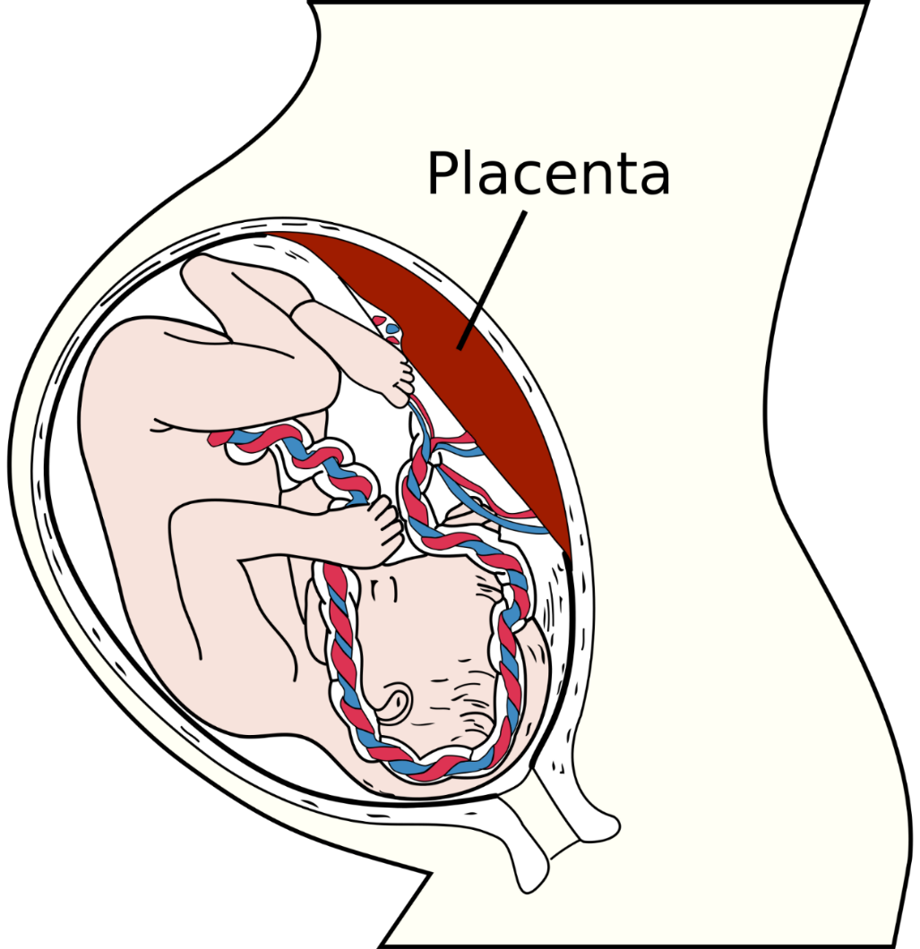
Elselijn:
the sum of foster, placenta and umbilical cord “grows directly into (or out of) the uterine wall, just as a tail grows out of the cat”
(“Pregnant Mereology”, 2016)

Slide 54
Elselijn’s view
we are parts of our mother post-implantation and pre-birth, because we are connected to our mother (as any other organ is connected to its host) via the umbilical cord
Marsupials have no umbilical cord

Slide 55
Three kinds of mammals – three kinds of protection
placental (wall of amniotic cavity)
marsupial (pouch)
merotremes (egg)

Slide 56
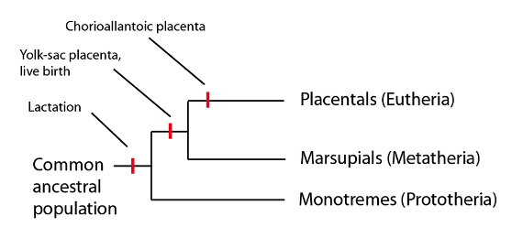
Notes:
http://www.life.umd.edu/classroom/bsci338m/Lectures/Monotremes.html. See also: https://embryology.med.unsw.edu.au/embryology/index.php/File:Emergence_of_traits_along_the_mammalian_lineage.jpg

Slide 57
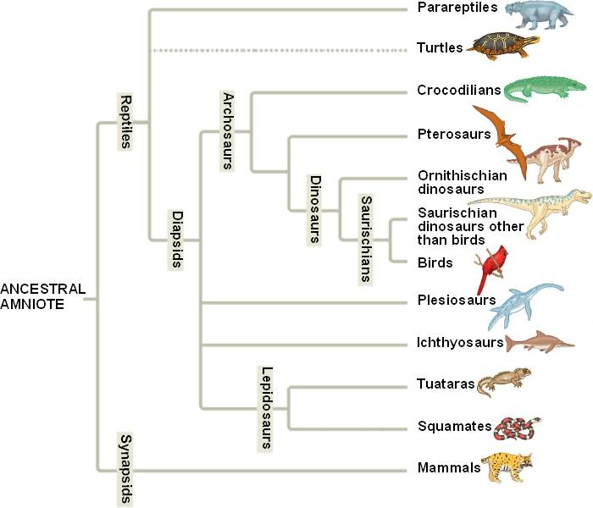
Amniotes
Notes:
http://bio1151.nicerweb.com/Locked/media/ch34/amniotes.html

Slide 58
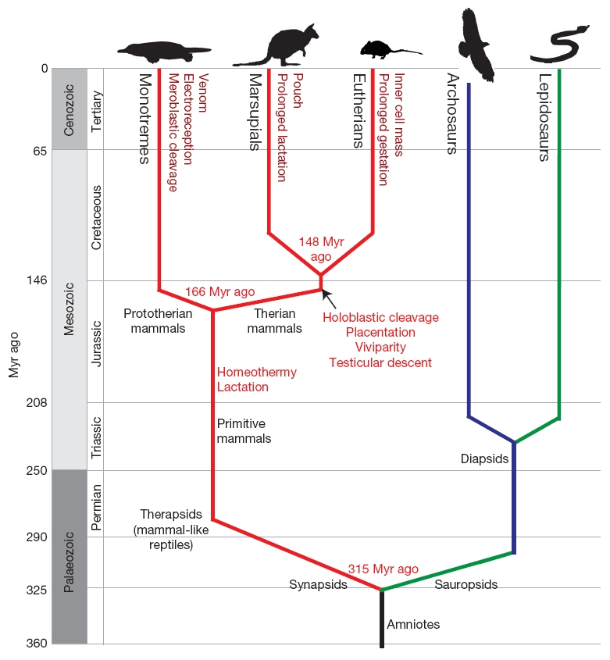
Notes:
https://www.nature.com/scitable/topicpage/interpreting-shared-characteristics-the-platypus-genome-44568

Slide 59
Amniotes
Amniotes = lay their eggs on land or retain the fertilized egg within the mother

Slide 60
yolk

Slide 62
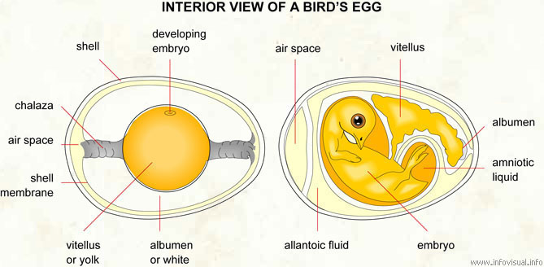
Notes:
https://infovisual.info/en/biology-animal/egg

Slide 63
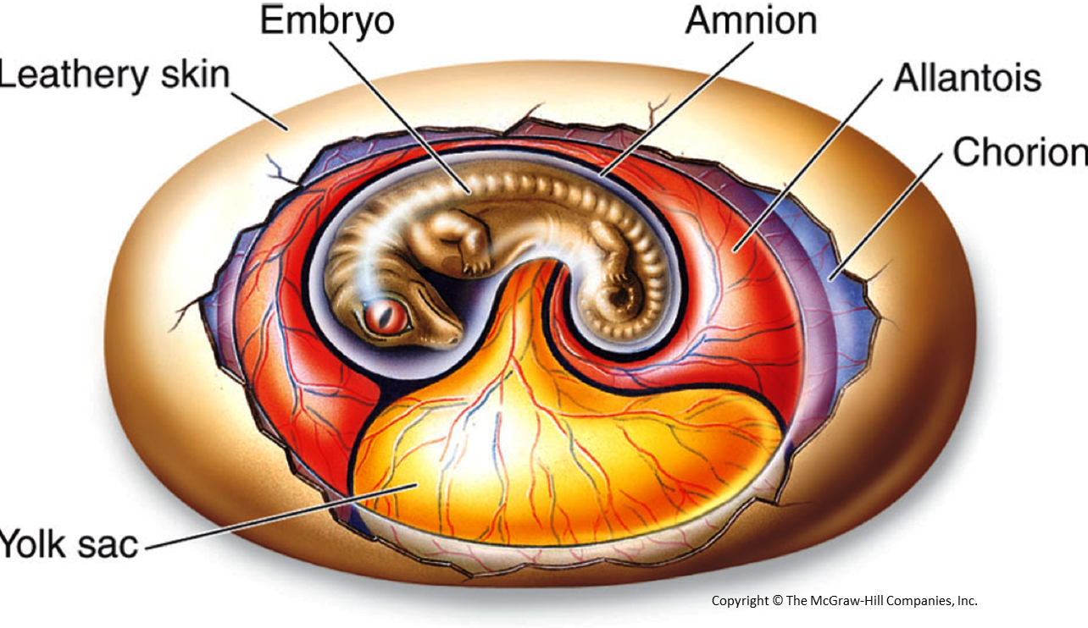
Reptile egg
Notes:
http://borbl426-526.blogspot.com/2014/01/lab-1-general-anatomy-of-reptiles.html

Slide 64
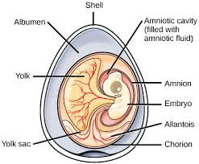
crocodile egg
Notes:
https://www.boundless.com/biology/textbooks/boundless-biology-textbook/vertebrates-29/reptiles-174/characteristics-of-amniotes-670-11892/

Slide 65
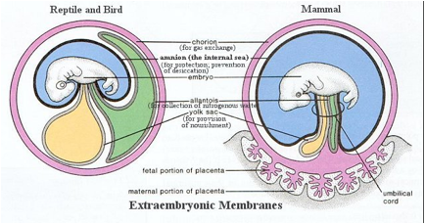
Reptile and bird Placental mammal
Notes:
http://sunny.moorparkcollege.edu/~econnolly/F11development.htm

Slide 66
Containment = protection
For all mammals (and for all reptile and all birds) the pregnancy process is ontologically the same. In each case there is a capsule involved
to keep the foster separate from, but close to, the mother, and
to ensure for the foster an appropriate avenue of (appropriately timed) escape.
This capsule may be:
A. an egg
B. a pouch
C. a multi-layered structure, the outer layer of which involves a unique fetal organ called the placenta.

Slide 67
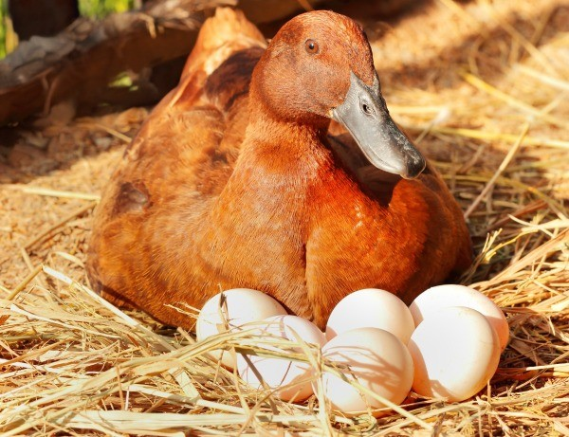
chick inside egg is not a part of mother

Slide 68
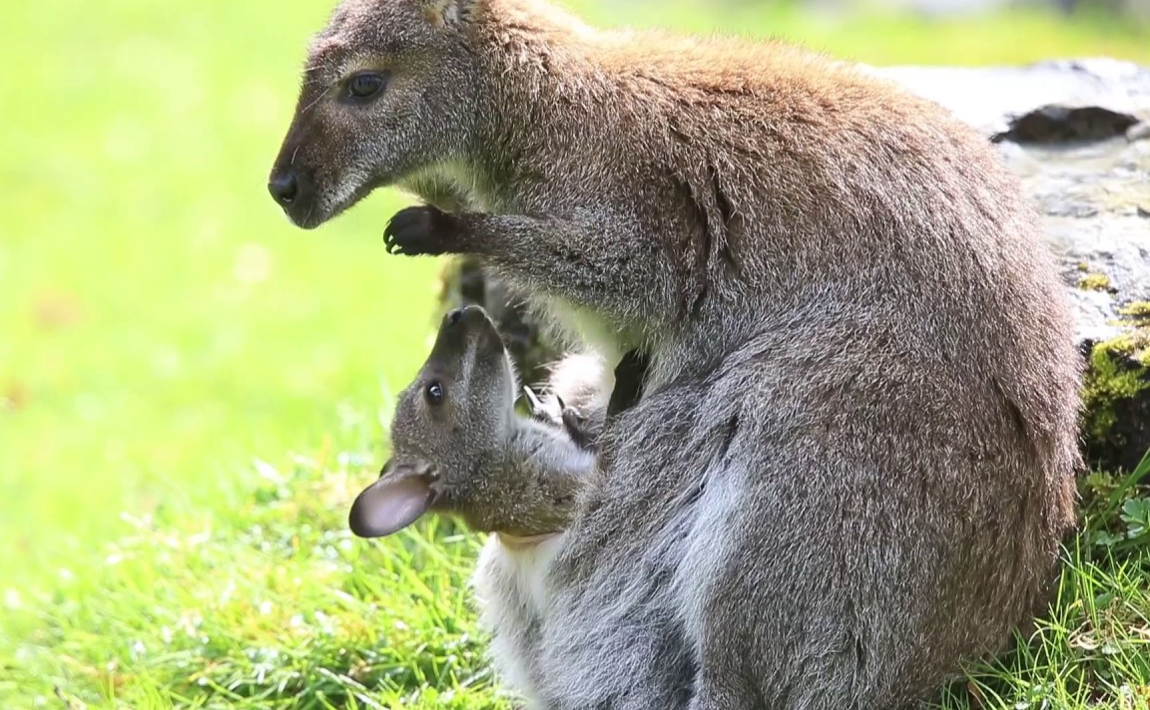
joey inside pouch is not a part of mother
Notes:
https://fr.123rf.com/photo_12038009_kangaroo-femme-avec-un-b%C3%A9b%C3%A9-joey-dans-la-poche-gros-plan.html

Slide 69
Bird is an egg layer; mammalian mother is an egg harborer
Notes:
http://sunny.moorparkcollege.edu/~econnolly/F11development.htm

Slide 70
… mammalian mother is an egg haven
Notes:
http://sunny.moorparkcollege.edu/~econnolly/F11development.htm

Slide 71
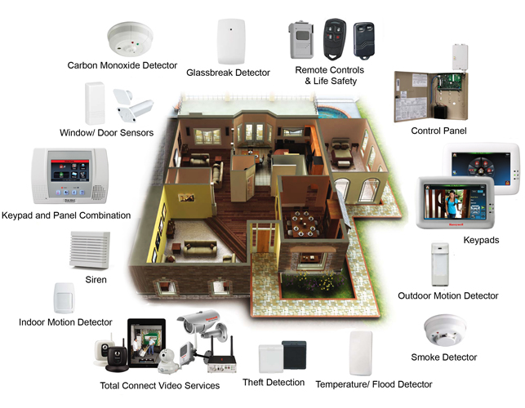
providing sophisticated regulatory mechanisms through the placenta
egg hotel
Notes:
https://security1online.wordpress.com/tag/wireless-security/

Slide 72
not the mother is the container, but the inner and outer membrane (and in some cases the shell) of the egg
Notes:
http://sunny.moorparkcollege.edu/~econnolly/F11development.htm

